Slide 1
MINI PROJECT PRESENTATION
Python 3.x Engine & Web UI
Lyrics Similarity Detection
Using String Matching
A KMP-based engine for comparing song lyrics, scoring similarity, and flagging potential plagiarism.
PROJECT TEAM
TEAM LEAD
TEAM MEMBER
TEAM MEMBER
Kavi Krishna
Hemanth
Prajwal
2520080021
25230090074
2520080017
Live Implemented Platform

Slide 2
TABLE OF CONTENTS
Slide 02 / 13
Presentation Agenda
01
Abstract & Core Tech
06
Platform UI: Home Dashboard
Project summary & algorithm stack
Live interface showcase
02
Introduction & Context
07
Platform UI: Similarity Detection
Industry motivation & significance
KMP, Cosine & Jaccard execution
03
Literature Survey
08
Platform UI: Plagiarism Risk
Review of string & text techniques
High risk flagging & passage diffs
04
Problem & Objectives
09
Platform UI: Ranked Gallery
Goals and target milestones
Visual match gallery & player
05
Proposed Methodology
10
Conclusion & Roadmap
5-step detection pipeline
Summary & future enhancements

Slide 3



01 · EXECUTIVE SUMMARY
Slide 03 / 13
Project Abstract
Automated Lyrical Originality & Plagiarism Detection
This project presents an end-to-end Lyrics Similarity Detection Engine & Web Platform that compares query song lyrics against a catalogue to identify matching passages and flag potential plagiarism.
KMP Algorithm
Fast exact substring detection
Built in Python, the system preprocesses lyrics (lower-casing, punctuation removal, tokenisation), applies the Knuth-Morris-Pratt (KMP) algorithm for exact substring matching, and calculates similarity using Cosine Similarity and Jaccard Similarity.
Cosine Similarity
Vector-based term overlap
Jaccard Similarity
Offers an interactive, dark-mode web application for instant lyrical overlap scoring.
Set intersection ratio

Slide 4
02 · INDUSTRY CONTEXT
Slide 04 / 13
Introduction & Motivation
The Challenge
KEY VALUE PROPOSITION
Lyric theft and unintentional overlap are common in the music industry, and manually comparing songs for similarity is slow and error-prone.
Why It Matters
Protects Originality: Safeguards intellectual property before commercial release.
Speeds Copyright Checks: Eliminates manual review bottlenecks.
Objective Scoring: Replaces subjective "ear-tests" with quantifiable metrics.
Automated Solution
This project builds an automated engine and interactive dashboard that inputs query lyrics, compares them against a catalogue, and surfaces matched passages with a numeric score.
Python 3 · Interactive Dark UI · 100% Local Processing

Slide 5
03 · EXISTING WORK
Slide 05 / 13
Literature Survey
Focus Area | Technique | Key Observation
Exact String-Matching | KMP / Boyer-Moore | Efficient for locating exact repeated phrases, but misses paraphrased or reordered lyrics.
Vector-Space Text Similarity | Cosine Similarity (TF-IDF) | Captures overall lexical overlap between documents; sensitive to vocabulary size.
Set-Based Similarity | Jaccard Similarity | Simple and fast for short texts like song verses; ignores word order and frequency.
Plagiarism-Detection Systems | Turnitin-style Tools | Widely used for academic text; general-purpose, not tuned for lyrical structure or rhyme.
Design Insight: Hybridizing KMP exact matching with Cosine and Jaccard metrics covers both literal sequence theft and broader lexical overlap.

Slide 6
04 · GOALS & SCOPE
Slide 06 / 13
Problem Statement & Objectives
1
Preprocess & Normalise
PROBLEM STATEMENT
Clean raw lyrics via lower-casing, punctuation removal & tokenisation.
Unchecked Lyrical Duplication
There is no lightweight, automated way to check whether a new song's lyrics closely resemble an existing one — making plagiarism checks slow, manual, and inconsistent.
2
KMP String Matching
Locate exact matching substrings using prefix table lookups.
3
Multi-Metric Scoring
Compute Cosine and Jaccard similarity metrics for statistical overlap.
4
Interactive Web Interface
High risk of copyright disputes
Display plagiarism warnings, diff views, and ranked similarity galleries.

Slide 7
05 · EXECUTION PIPELINE
Slide 07 / 13
Proposed Methodology
STEP 01
STEP 02
STEP 03
STEP 04
STEP 05
1. Input
2. Preprocess
3. Match (KMP)
4. Score
5. Web UI
Collect query song lyrics and load reference catalogue.
Lower-case, strip punctuation & tokenise raw text.
Locate exact/near-exact substrings efficiently.
Apply Cosine & Jaccard similarity metrics.
Display plagiarism alerts & ranked gallery.
Raw Lyrics Data
Token Cleanse
KMP Substrings
Dual Metrics
Interactive UI
Balanced Approach: Combines deterministic string matching (KMP) with statistical similarity measures for optimal precision and recall.
Hybrid Architecture

Slide 8


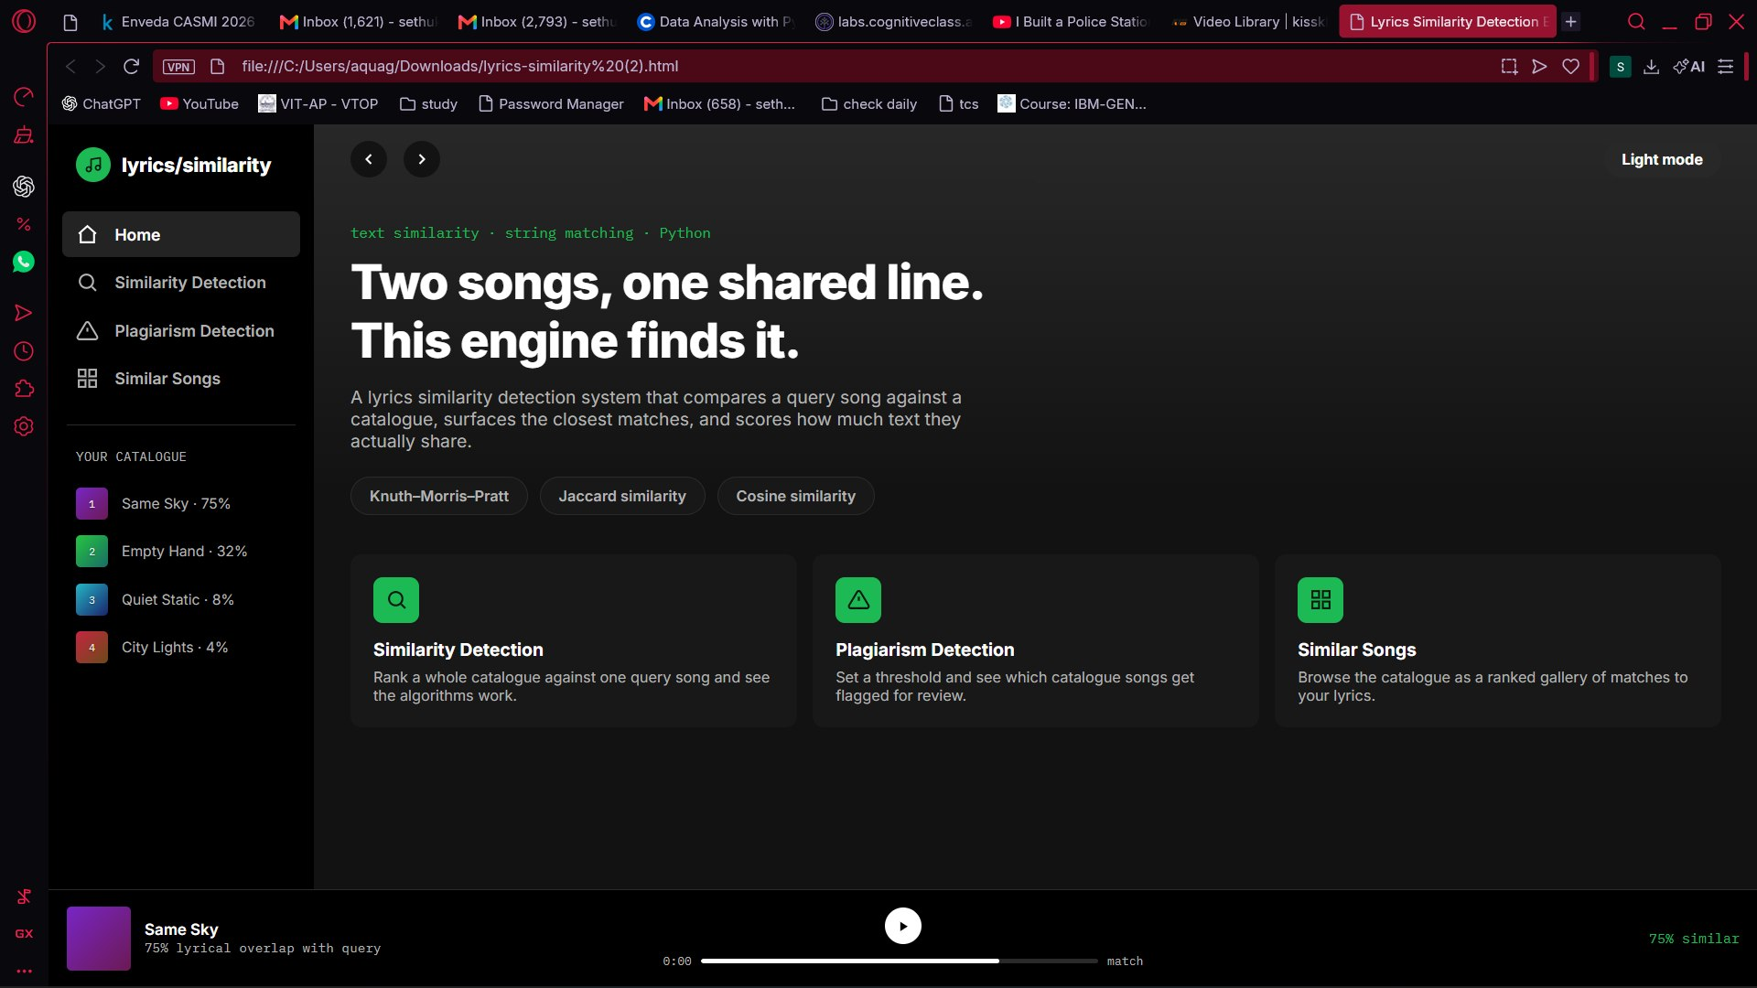
06 · PLATFORM IMPLEMENTATION SHOWCASE
Slide 08 / 13
Platform Interface & Dashboard
Modern Dark Theme UI
Features an intuitive sidebar navigation providing seamless access to Home, Similarity Detection, Plagiarism Detection, and Similar Songs.
Core Dashboard Metrics
4 Songs Catalogue loaded locally
3 Matching Algorithms active (KMP, Cosine, Jaccard)
100% Local Processing for instant results

Slide 9
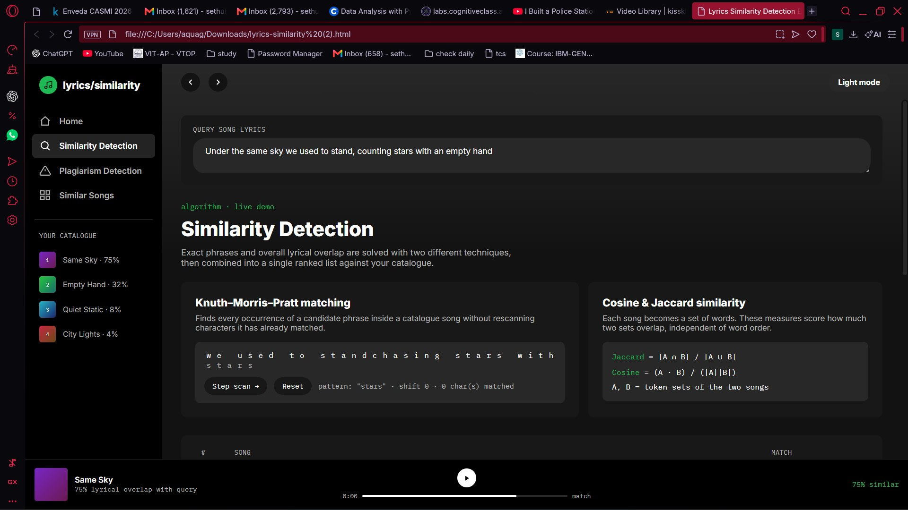
07 · ENGINE EXECUTION
Slide 09 / 13
Multi-Metric Similarity Detection Module
KMP Substring Match
3 Matches
Identifies exact phrase overlaps in real-time without redundant scanning.
Cosine Similarity
82% Overlap
Measures lexical vector alignment and term frequency across lyrics.
Jaccard Index
68% Unique Set
Calculates word set intersection over union ratio for unique vocabulary.

Slide 10
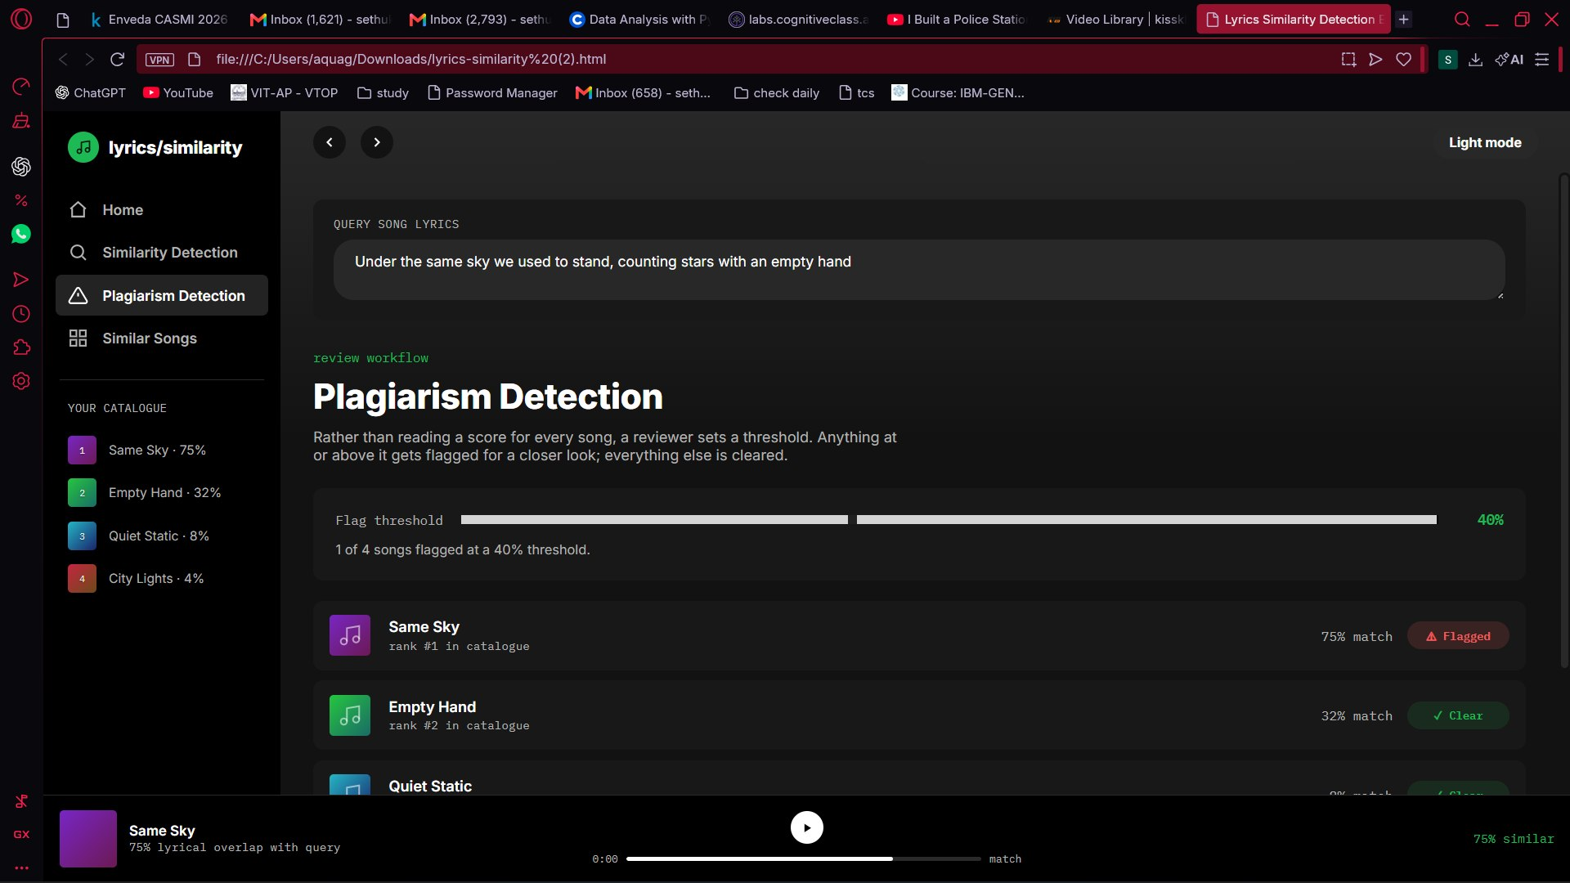
08 · RISK ASSESSMENT
Slide 10 / 13
Plagiarism Flagging & Passage Analysis
Risk Alert
High Plagiarism Risk (75%)
Flagged song: "Same Sky" — 3 matching passages detected against query.
Passage Breakdown:
Match 1 (Exact Line)
100% Match
Match 2 (Chorus Variant)
67% Match
Match 3 (Verse Phrase)
50% Match

Slide 11
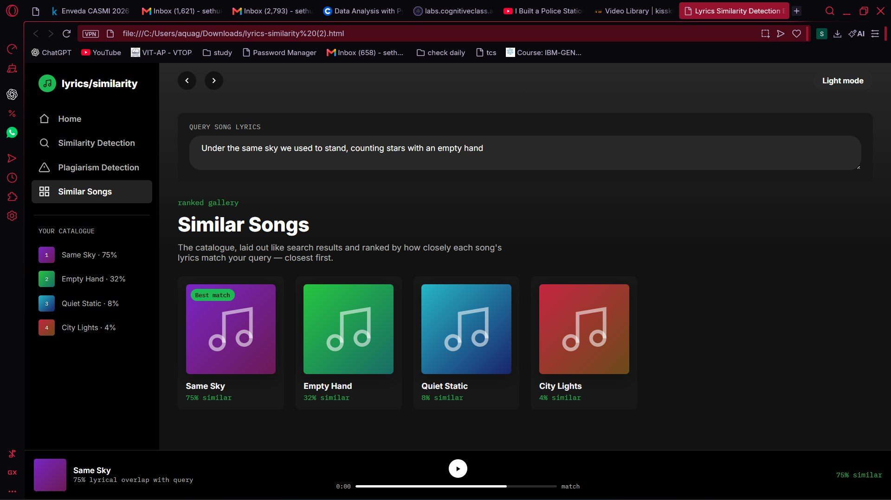
09 · VISUAL GALLERY
Slide 11 / 13
Ranked Similar Songs Gallery
BEST MATCH
75% Similar
1. Same Sky
Top ranked lyrical overlap with query verse.
2. Empty Hand
32% Similar
3. Quiet Static
8% Similar
4. City Lights
4% Similar

Slide 12
10 · ROADMAP & CLOSING
Slide 12 / 13
Conclusion & Future Scope
Project Conclusion
The implemented system combines deterministic string matching with statistical text similarity techniques in a modern web platform. It eliminates manual effort in plagiarism detection, providing songwriters, publishers, and platforms a practical first line of defence.
FUTURE ENHANCEMENT SCOPE
1. Deep Embeddings
2. Audio Matching
3. Multilingual
4. Real-Time API
Use transformers to catch semantic & paraphrased similarity.
Extend checks beyond text to melody and rhythm patterns.
Support lyric comparison across multiple languages and scripts.
Expose engine as a cloud API service for streaming platforms.

Slide 13
PROJECT DEFENSE & Q&A
Slide 13 / 13
Thank You!
Questions & Discussion
PRESENTED BY
Roll Nos: 2520080021 · 25230090074 · 2520080017
Kavi Krishna · Hemanth · Prajwal

